Slide 1

Data 205 Final Project
David Williams

Slide 2
Contents
Housing Code Violations
Montgomery College Enrollment
Tuition Assistant
College Level Characteristics from the IPEDS Database and the College Scorecard
National Automotive Sampling System Crashworthiness Data System (NASS-CDS)
Community Health Status Indicators (CHSI) to Combat Obesity, Heart Disease and Cancer
NCHS - Death rates and life expectancy at birth

Slide 3
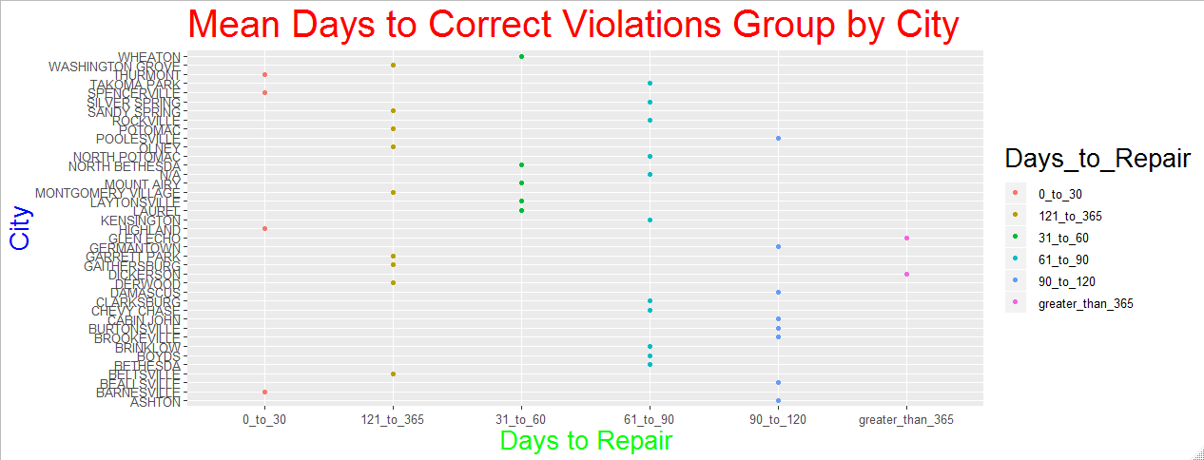

Slide 4
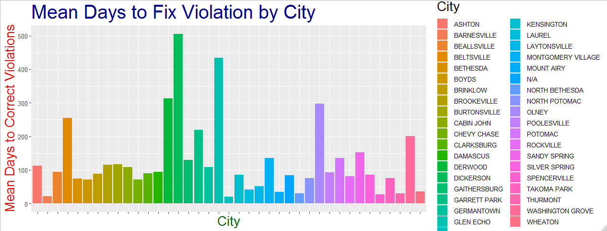

Slide 5
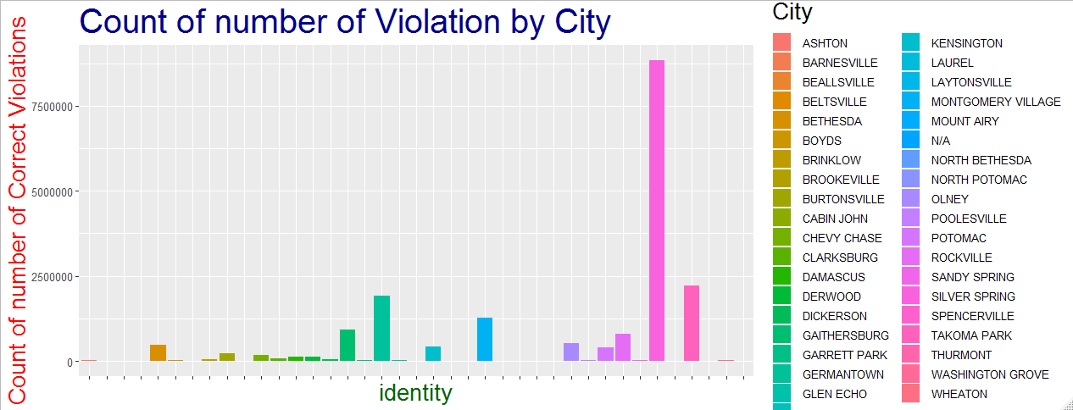

Slide 6
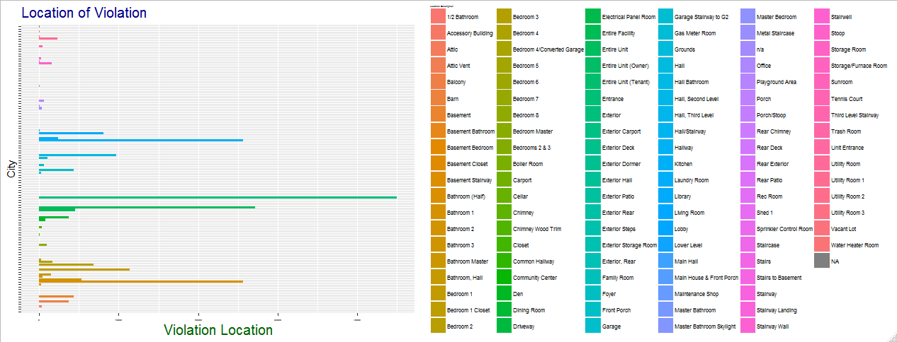

Slide 7
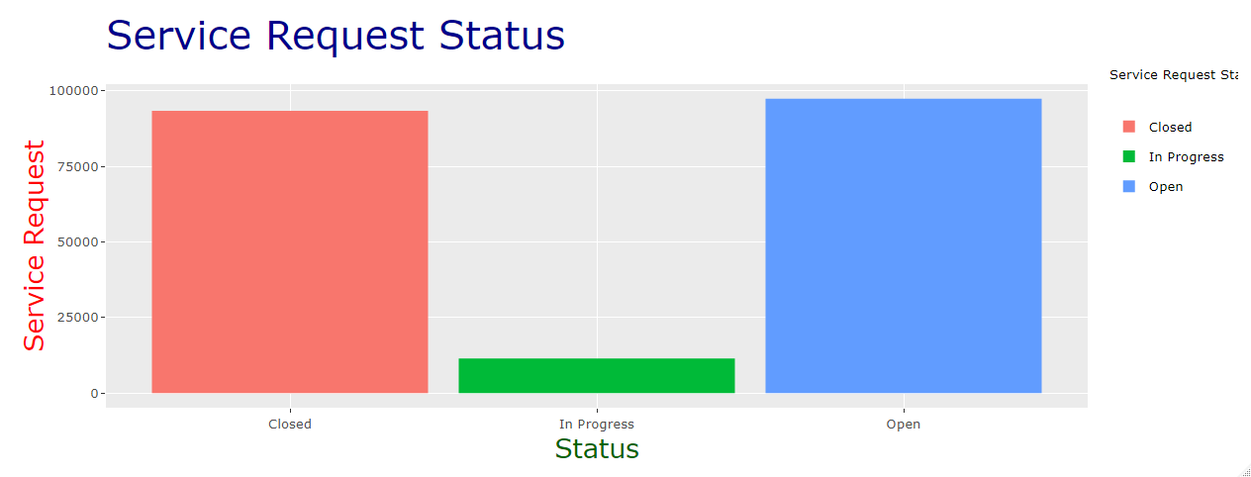

Slide 8
Montgomery College Enrollment

Slide 9
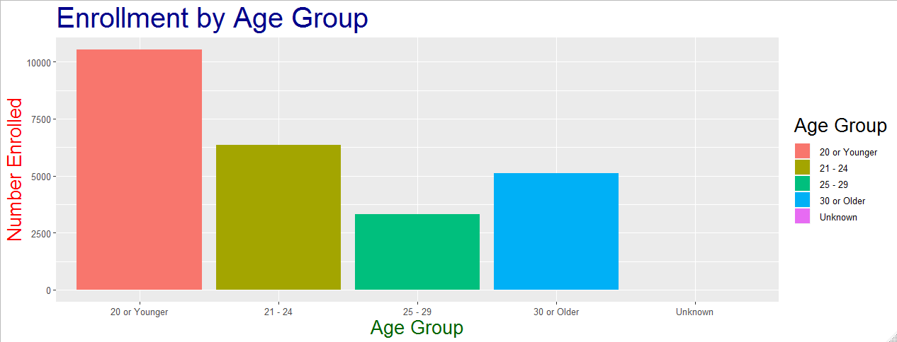

Slide 10
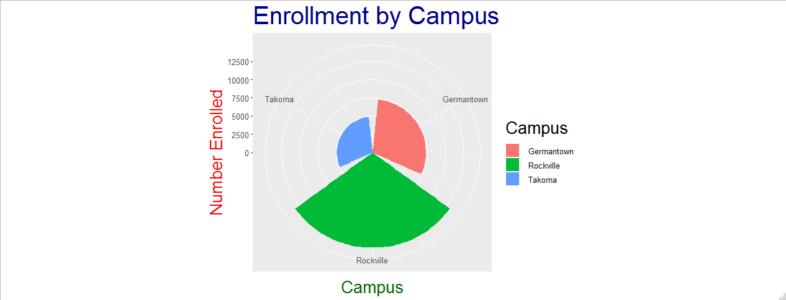

Slide 11
Tuition Assistant
https://public.tableau.com/profile/david.williams8099#!/vizhome/TuitionAssistant/CountofDegreesbyDepartment?publish=yes
https://public.tableau.com/profile/david.williams8099#!/vizhome/TuitionAssistant/CountofMajorperDegree?publish=yes
https://public.tableau.com/profile/david.williams8099#!/vizhome/TuitionAssistant/AvgCostperDepartment?publish=yes

Slide 12
College Level Characteristics from the IPEDS Database and the College Scorecard

Slide 13
Tableau
https://public.tableau.com/profile/david.williams8099#!/vizhome/montgomerycountycolleges/MontgomeryCollegeDashboard?publish=yes
https://public.tableau.com/profile/david.williams8099#!/vizhome/averageearningbyschool/Sheet1?publish=yes
https://public.tableau.com/profile/david.williams8099#!/vizhome/averageearningbyschool/Sheet2?publish=yes

Slide 14

National Automotive Sampling System Crashworthiness Data System (NASS-CDS)

Slide 15
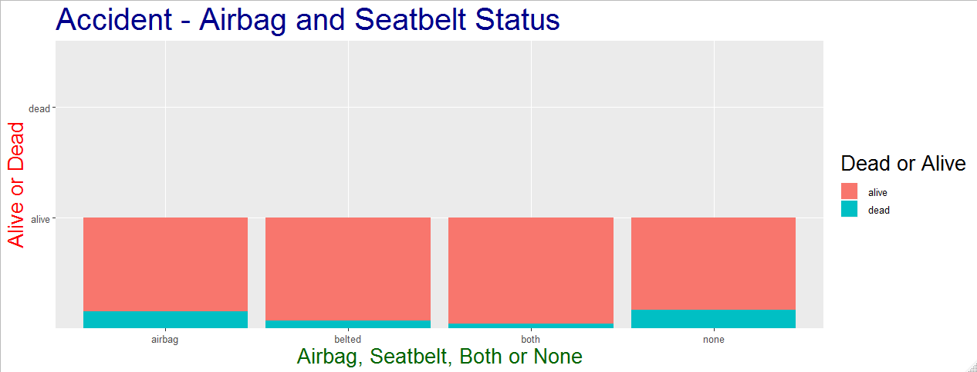

Slide 16
 | Alive | Dead
Airbag | 2989 | 276
Belted | 7154 | 265
Both | 10919 | 235
None | 3975 | 404

Slide 17
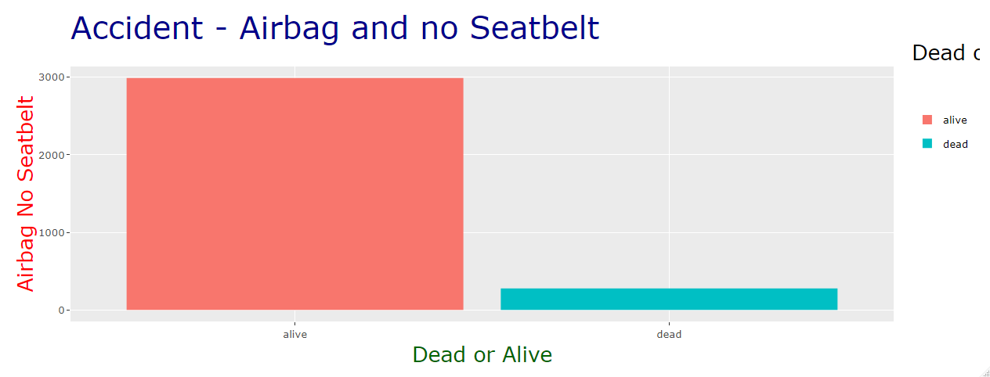

Slide 18
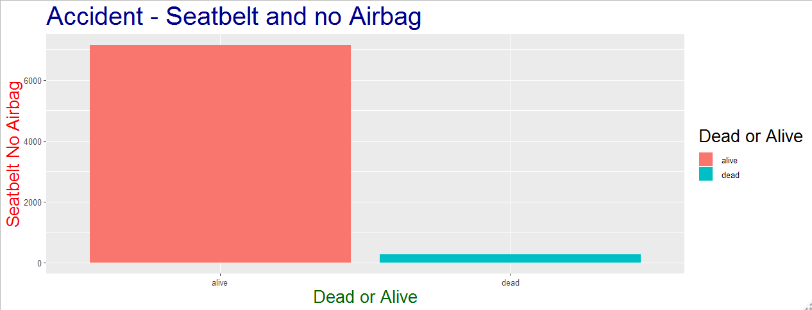

Slide 19
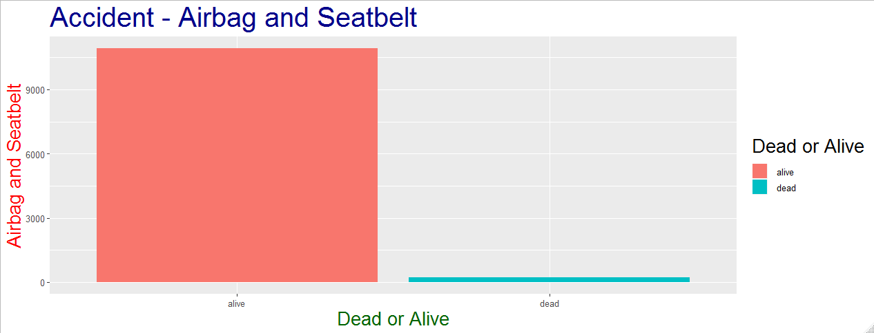

Slide 20
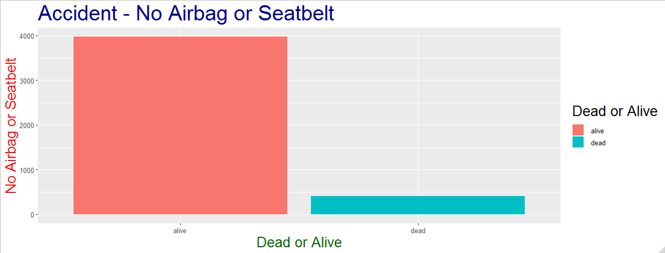

Slide 21
Community Health Status Indicators (CHSI) to Combat Obesity, Heart Disease and Cancer

Slide 22
Montgomery County
ALE 81.3

Slide 23
------------------------------- State Level ------------------------------------
72 | 0
73 | 0
74 | 0000
75 | 000000
76 | 00000000
77 | 00000000000000
78 | 00000000000000
79 | 00
80 | 0
Frequency Table of ALE for State
ALE 72 73 74 75 76 77 78 79 80
Count 1 1 4 6 8 14 14 2 1
Descriptive Statistics for the State level
Minimum 1st Quartile Median Mean 3rd Quartile Maximum SD
72 75.88 76.97 76.65 77.79 79.66 1.597046

Slide 24
State | ALE |  | State | ALE |  | State | ALE
AL | 74.1 |  | KY | 75 |  | ND | 77.6
AK | 76.9 |  | LA | 73.9 |  | OK | 74.6
AZ | 76.9 |  | ME | 77.25 |  | OH | 76.45
AR | 74.7 |  | MD | 76.9 |  | OK | 74.6
CA | 77.8 |  | MA | 78.5 |  | OR | 77.15
CO | 78.15 |  | MI | 76.9 |  | PA | 77
CT | 78.75 |  | MN | 79 |  | RI | 79.1
DE | 76.5 |  | MS | 73.4 |  | SC | 74.65
DC | 72 |  | MO | 75.8 |  | SD | 78
FL | 76.5 |  | MT | 76.9 |  | TN | 74.4
GA | 73.9 |  | NE | 78.3 |  | TX | 76.05
HI | 80.4 |  | NV | 75.7 |  | UT | 77.8
ID | 77.6 |  | NH | 78.1 |  | VT | 78
IL | 77.1 |  | NJ | 77.6 |  | VA | 76.1
IN | 76.4 |  | NM | 77 |  | WA | 77.7
IA | 78.5 |  | NY | 77.55 |  | WV | 75.2
KS | 77.6 |  | NC | 75.4 |  | WI | 78
 |  |  |  |  |  | WY | 77.4

Slide 25
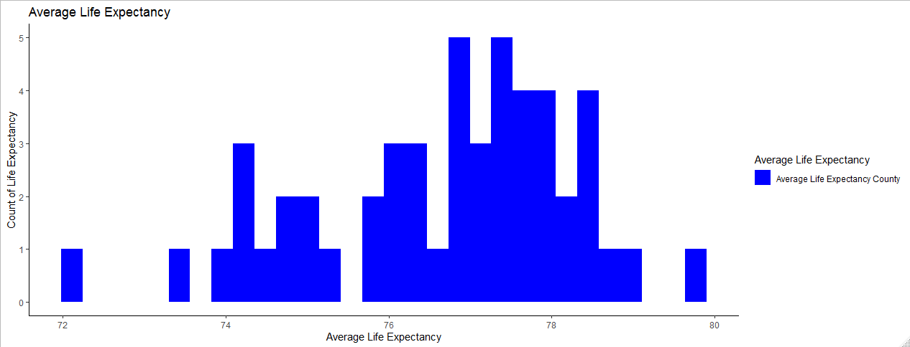

Slide 26
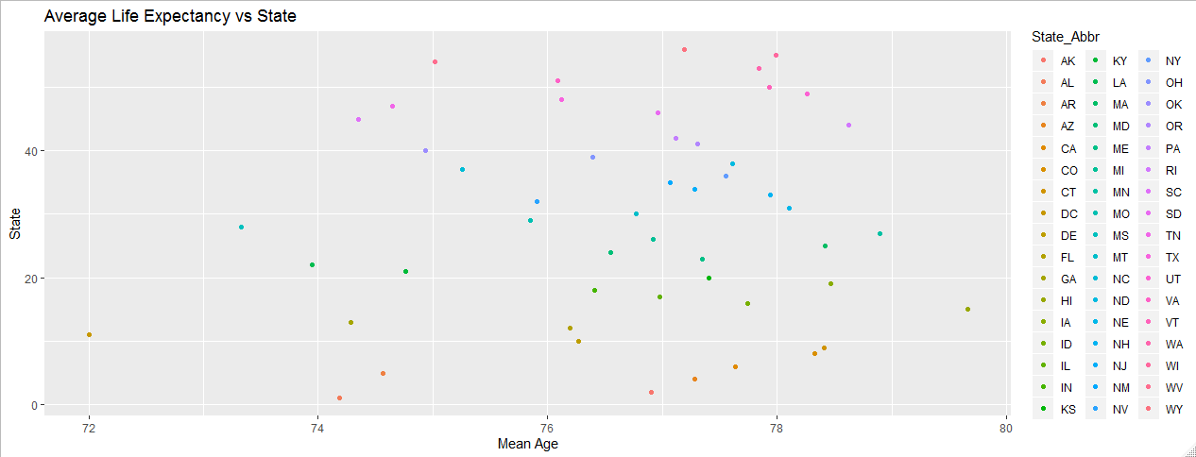

Slide 27
https://public.tableau.com/profile/david.williams8099#!/vizhome/AverageLifeExpectancy_15717865704230/ALEbyCounty?publish=yes
https://public.tableau.com/profile/david.williams8099#!/vizhome/AverageLifeExpectancy_15717865704230/ALEbyState?publish=yes

Slide 28
------------------------------- County Level ------------------------------------
Frequency Table of ALE for all Counties
ALE 67 69 70 71 72 73 74 75 76 77
Count 5 1 7 13 67 173 333 410 576 605
ALE 79 80 81
Count 225 100 39
Descriptive Statistics for all Counties
Minimum 1st Quartile Median Mean 3rd Quartile Maximum SD
66.6 75 76.5 76.32 77.7 81.3 1.9975

Slide 29
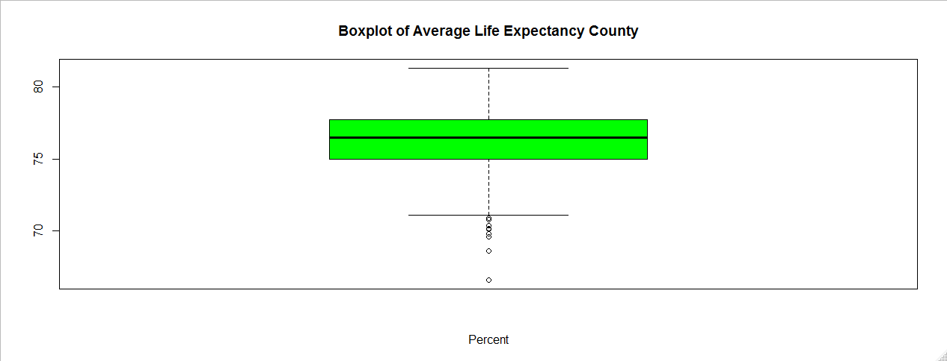

Slide 30
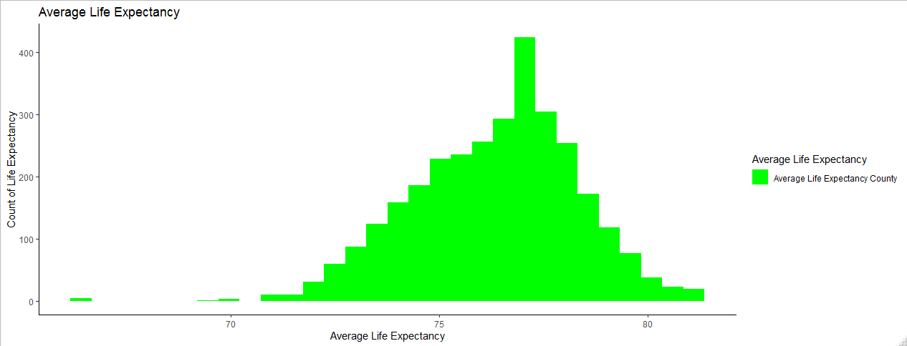

Slide 31

NCHS - Death rates and life expectancy at birth

Slide 32
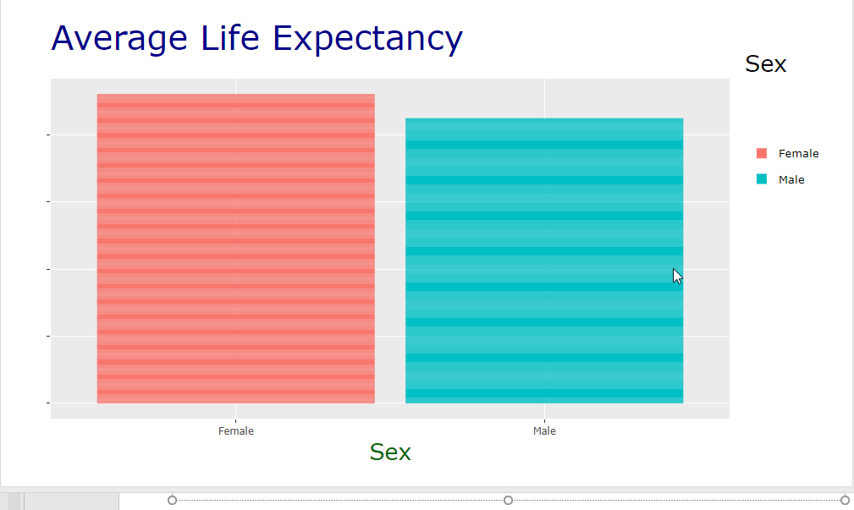

Slide 33
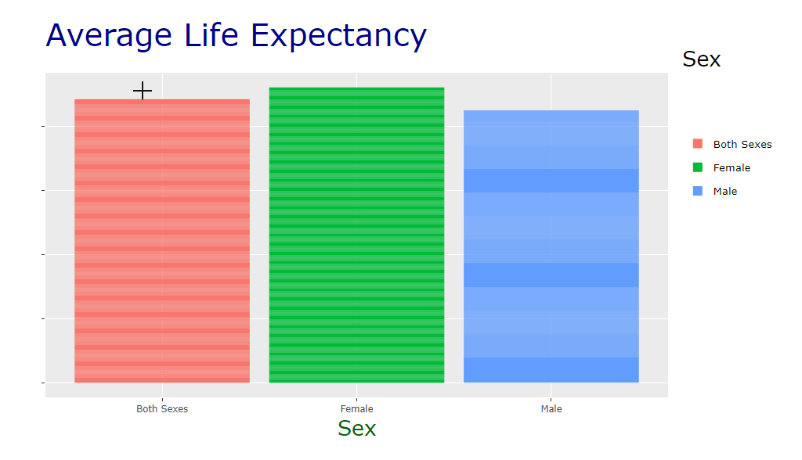

Slide 34
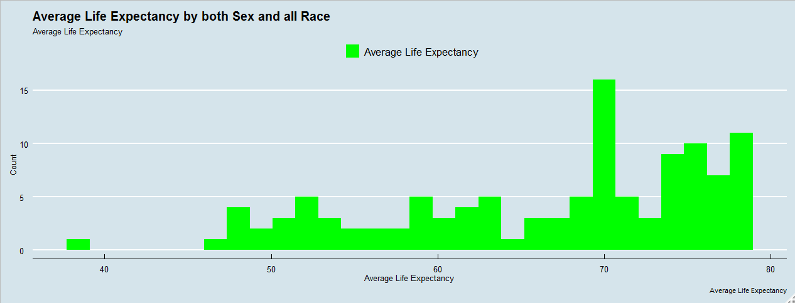

Slide 35
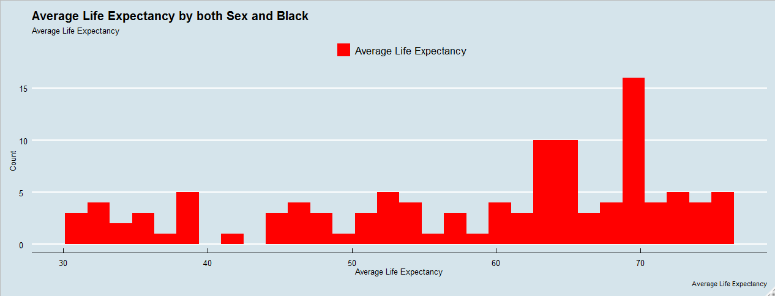

Slide 36
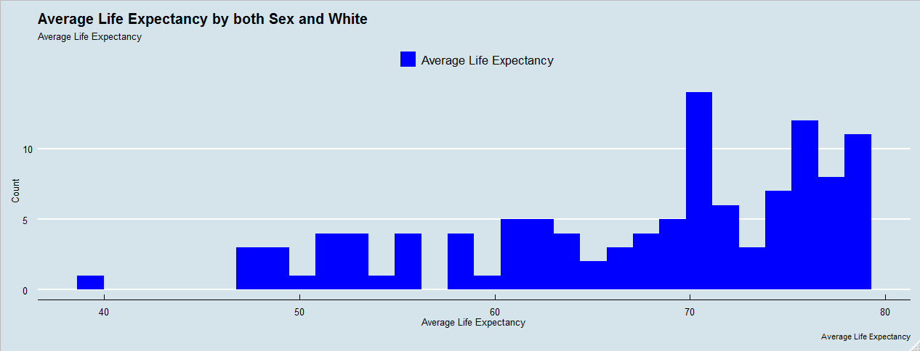

Slide 37
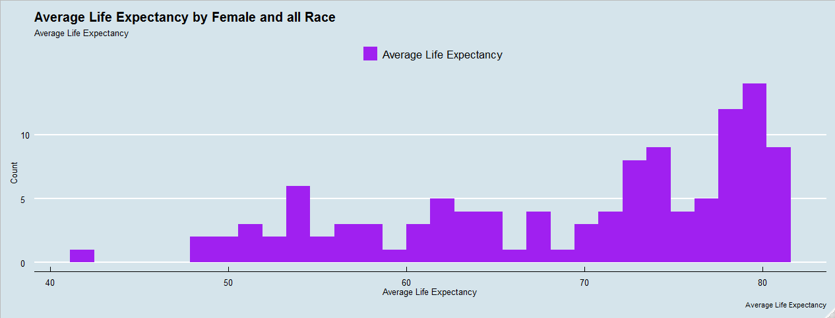

Slide 38
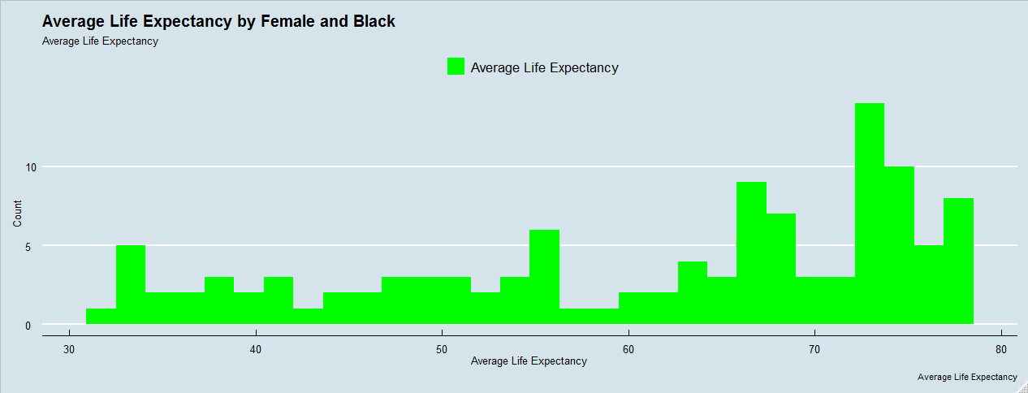

Slide 39
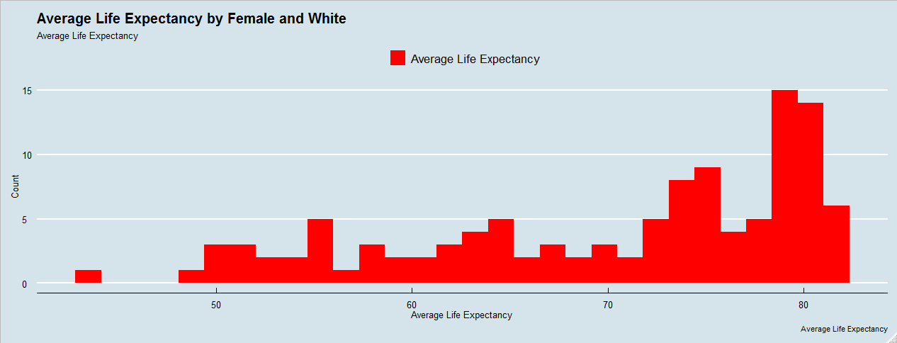

Slide 40
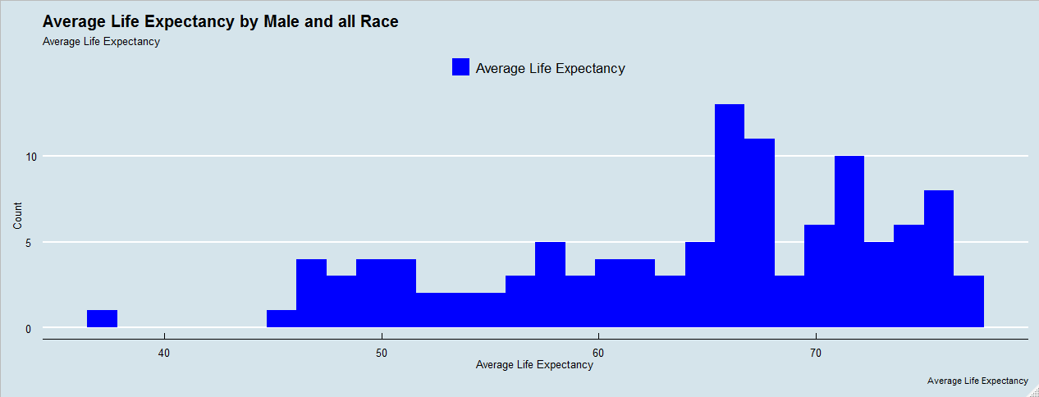

Slide 41
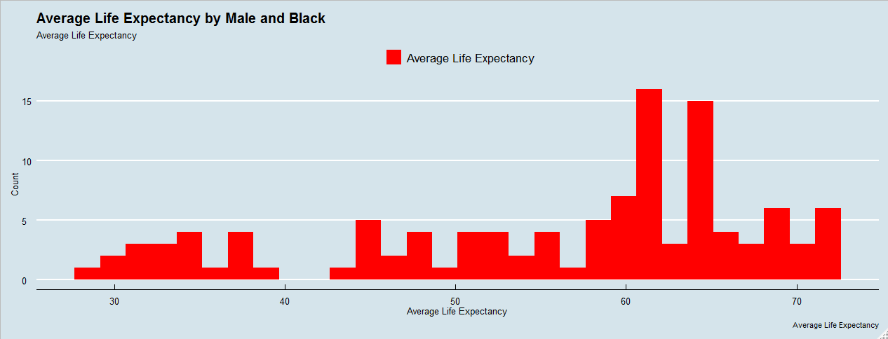

Slide 42
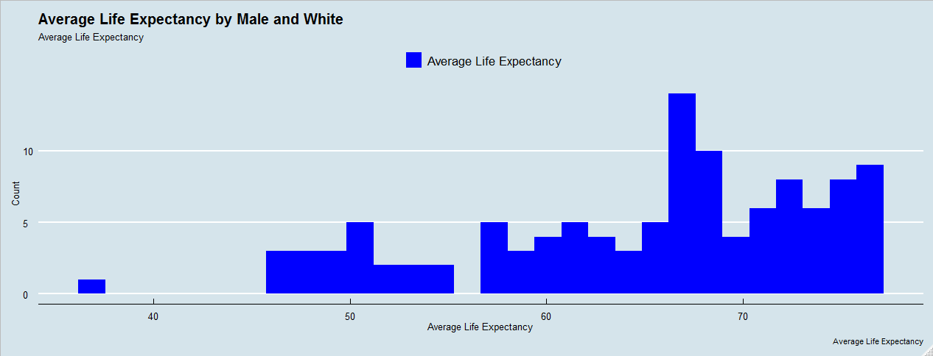

Slide 43
Reference
Housing Code Violations
https://data.montgomerycountymd.gov/Consumer-Housing/Housing-Code-Violations/k9nj-z35d
Montgomery College Enrollment
https://data.montgomerycountymd.gov/Education/Montgomery-College-Enrollment-Data/wmr2-6hn6
College Level Characteristics from the IPEDS Database and the College Scorecard
https://opportunityinsights.org/data/

Slide 44
Reference
Housing Code Violations
https://data.montgomerycountymd.gov/Consumer-Housing/Housing-Code-Violations/k9nj-z35d
Montgomery College Enrollment
https://data.montgomerycountymd.gov/Education/Montgomery-College-Enrollment-Data/wmr2-6hn6
Tuition Assistant
https://data.montgomerycountymd.gov/resource/p7z5-tjrz.csv
College Level Characteristics from the IPEDS Database and the College Scorecard
https://opportunityinsights.org/data/

Slide 45
Reference
National Automotive Sampling System Crashworthiness Data System (NASS-CDS)
https://www.kaggle.com/loveall/airbag-and-other-factors-on-accident-fatalities
Community Health Status Indicators (CHSI) to Combat Obesity, Heart Disease and Cancer
https://catalog.data.gov/dataset/community-health-status-indicators-chsi-to-combat-obesity-heart-disease-and-cancer - dataset: summarymeasureofhealth
NCHS - Death rates and life expectancy at birth
https://data.cdc.gov/NCHS/NCHS-Death-rates-and-life-expectancy-at-birth/w9j2-ggv5

